Slide 1
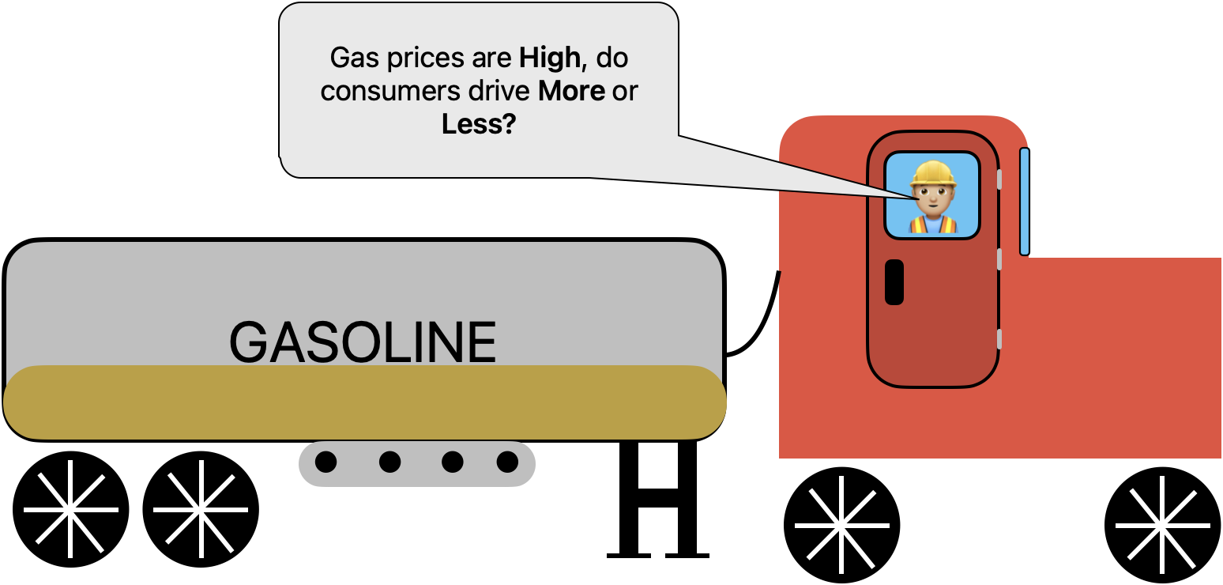

The Effect of Gas Prices on U.S. Gas Consumption
By: Nikolas Lee-Bishop

Slide 2
Index & Content
Dataset Selection
Overview
Consumption Data
Prices Data
Merging Datasets
Results and Conclusion

Slide 3
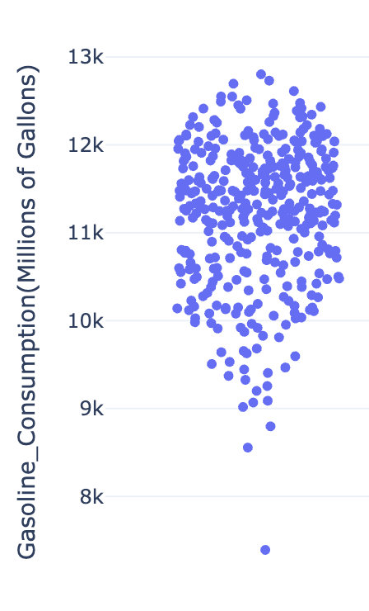
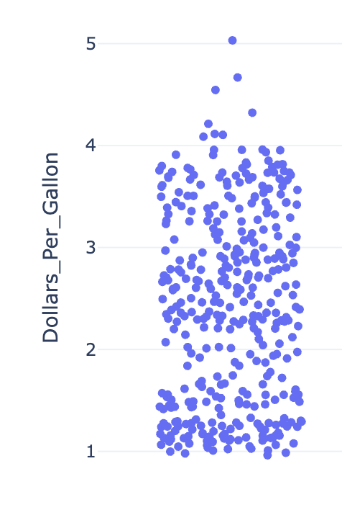
Dataset Selection
Consumption Data
‘Product Supplied for Finished Motor Gasoline’
U.S. Energy Information Administration (EIA)
Public source
Highly trusted
Frequent updates
Clear methodology
--------------------------------------
**Things to Note**
Doesn’t account for vehicular registrations
Data collection for prices is 1,000 randomly geographically dispersed stations collected weekly
Prices Data
‘U.S. Gasoline and Diesel Retail Prices’

Slide 4
Overview
Law of Supply and Demand:
Supply exceeds demand -> prices goes down
Law of Demand:
Prices go up -> demand goes down
Prices go down -> demand goes up
Inelastic Goods:
Goods not sensitive to change in prices due to lack of substitutions or is a necessity (Gasoline)
How does gasoline consumption respond to changes in gas prices?

Slide 5
Consumption Dataset
How the U.S. consumes gasoline

Slide 6
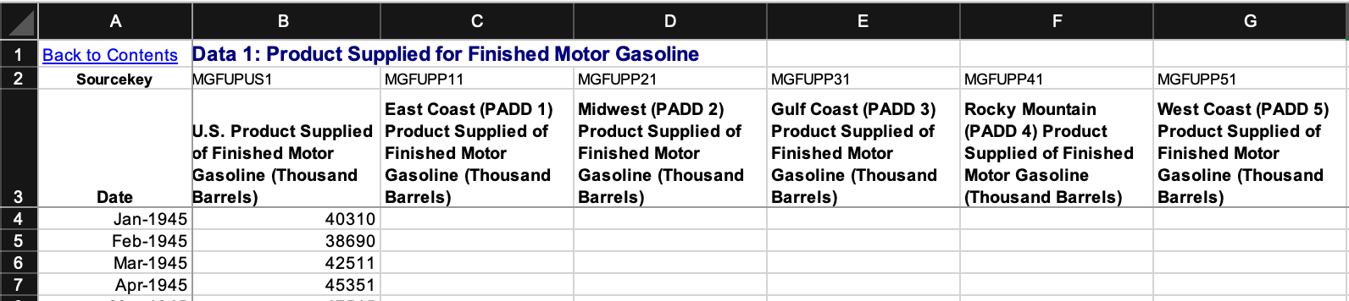
1.
2.
Consumption
Dataset
Cleaning
Remove 2 header columns
Remove 5 regional rows
Rename ‘U.S. Product Supplied for Finished Motor Gasoline (Thousand Barrels)’ to Gasoline Consumption (MIllions of Gallons)
3.
4.
Convert ‘Date’ to datetime
Filter Dates to 1/1/1994 to 12/31/2024
Convert values in Gasoline Consumption (MIllions of Gallons)
  Multiply by 1000
  Multiply by 42
  Divide by 1,000,000

Slide 7
Consumption Statistics
Summary Stats
Kurtosis
Skew
Outliers
Minimum: 7,390
Mean: 11,211
Maximum: 12,803
Std. Dev: 820
0.96
-> Slightly more peaked than normal distribution
-0.84
-> Slightly left skewed
-> Lower values were more common than higher values
8,555 (Feb 1994)
7,390 (April 2020)
-> Not being removed due to time linearity
*millions of gallons
*millions of gallons

Slide 8
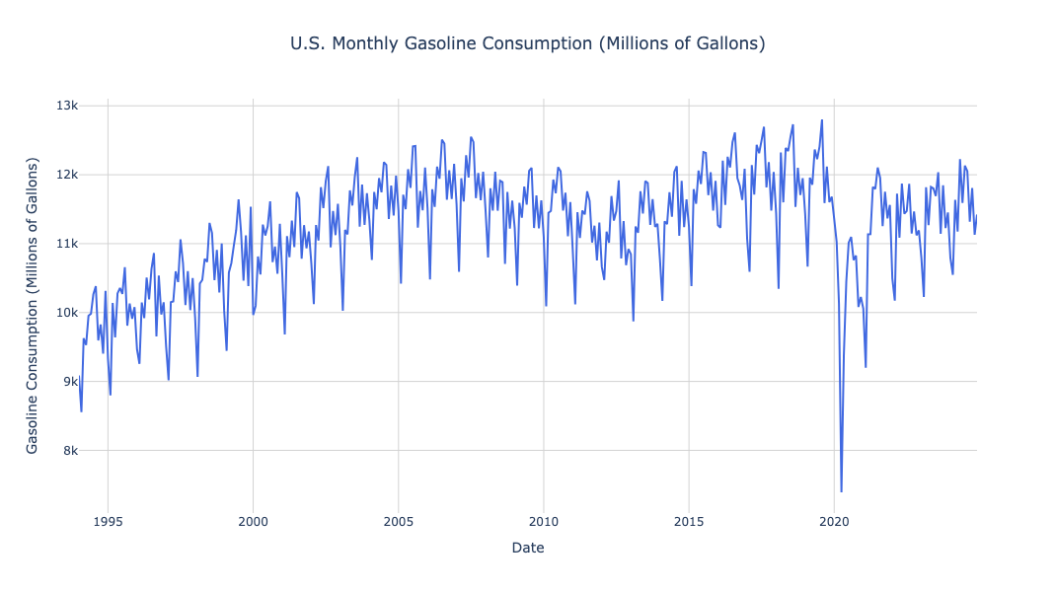
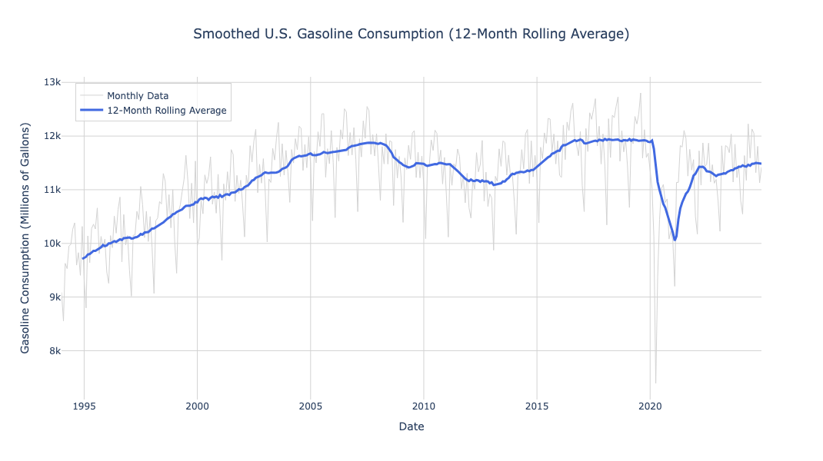
Summary Stats
Aug, 2019
Minimum: 7,390
Mean: 11,211
Maximum: 12,803
Std. Dev: 820
April, 2020
*millions of gallons
Things to note:
Seasonal pattern
Covid plunge
2008 - 2016 trough

Slide 9
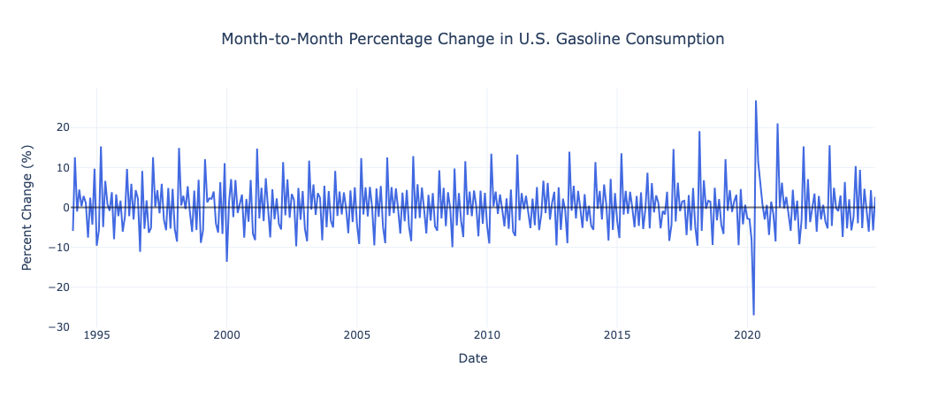
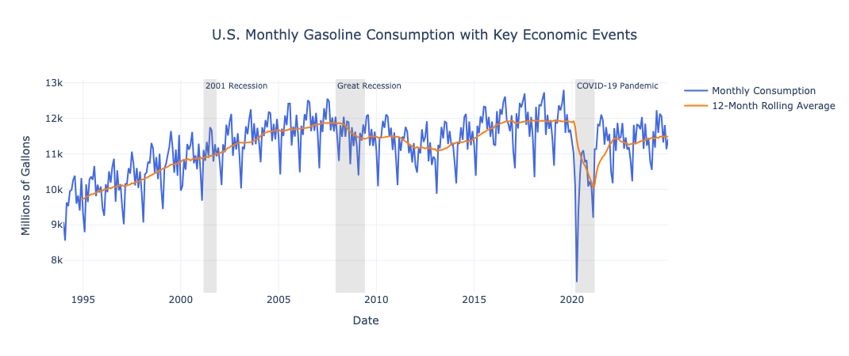
Notable Events
2001 (Dot-Com Bubble Burst, Recession, 9/11)
2008 (Great Recession)
2020 (COVID)

Slide 10
Prices
Dataset
Gasoline price trends in the U.S.

Slide 11
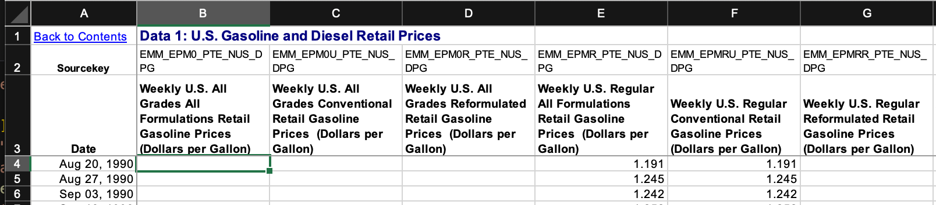
1.
2.
Prices
Dataset
Cleaning
Remove 2 header columns
Remove 14 fuel type rows
Rename ‘Weekly U.S. All Grades All Formulations Retail Gasoline Prices (Dollars per Gallon)’ to ‘Dollars Per Gallon’
3.
Convert ‘Date’ to datetime
Filter Dates to 1/1/1994 to 12/31/2024

Slide 12
Prices Statistics
Summary Stats
Kurtosis
Skew
Outliers
Minimum: $0.96
Mean: $2.41
Maximum: $5.03
Std. Dev: $0.94
-1.09
-> slightly flatter than normal distribution
0.13
-> distribution is nearly symmetrical
none

Slide 13
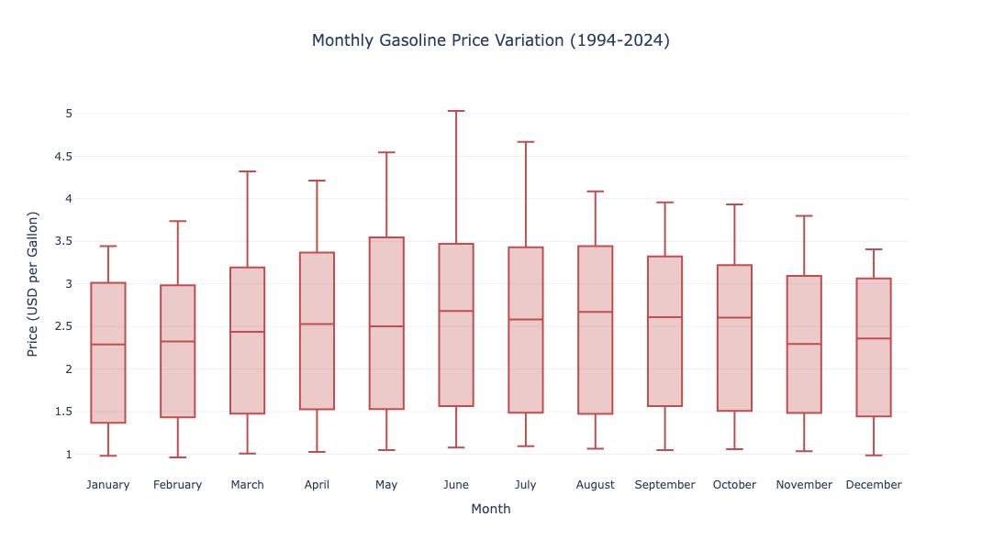
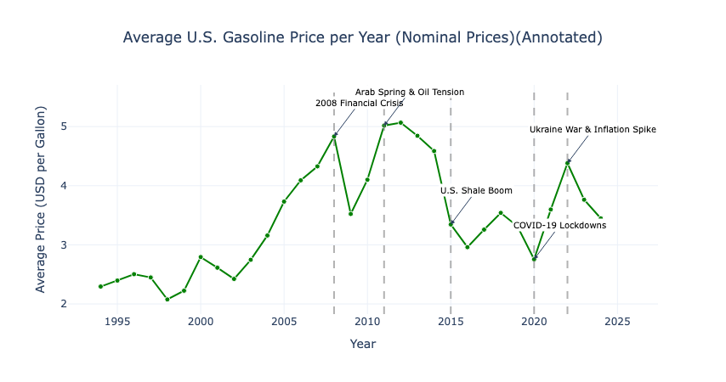
Things to note:
Seasonal pattern
  Summer is highest prices
  Dec/Jan are lowest prices

Slide 14
Prices
Dataset
Conversion for Inflation
1.
2.
Import FRED CPI dataset for 1994-2024
Merge Prices and CPI on ‘Date’
Drop ‘CPI’

Slide 15
Prices w/ Inflation Statistics
Inflation Stats
Nominal Stats
Minimum: $1.85
Mean: $3.42
Maximum: $5.92
Std. Dev: $0.94
Minimum: $0.96
Mean: $2.41
Maximum: $5.03
Std. Dev: $0.94

Slide 16
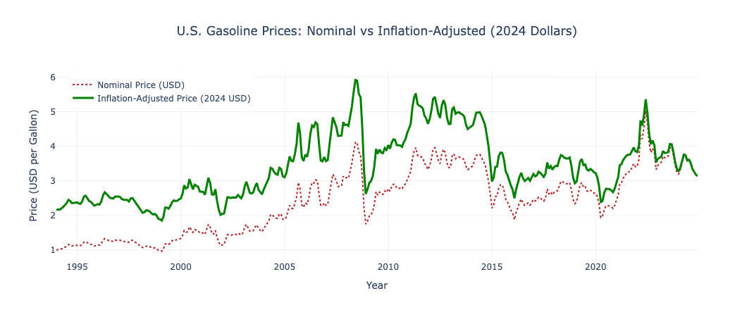
Things to note:
Inflation has less effect on more current prices than older prices

Slide 17
Merging
Price and Consumption

Slide 18
1.
2.
Merging Consumption and Prices
Keep ‘Date’, ‘Dollars Per Gallon’, ‘Price Adjusted’, and ‘Gasoline Consumption (MIllions of Gallons)’
Inner Merge on ‘Date’
3.
Rename ‘Dollars Per Gallon’ to ‘Nominal Price USD’ and ‘Price Adjusted’, to ‘Inflation Adjusted Price USD’

Slide 19
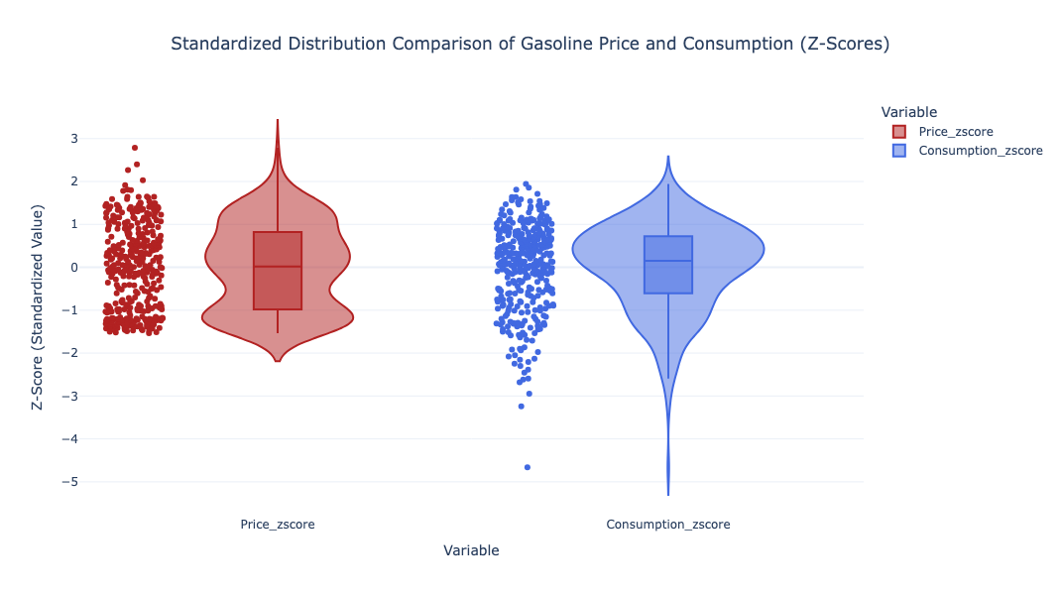
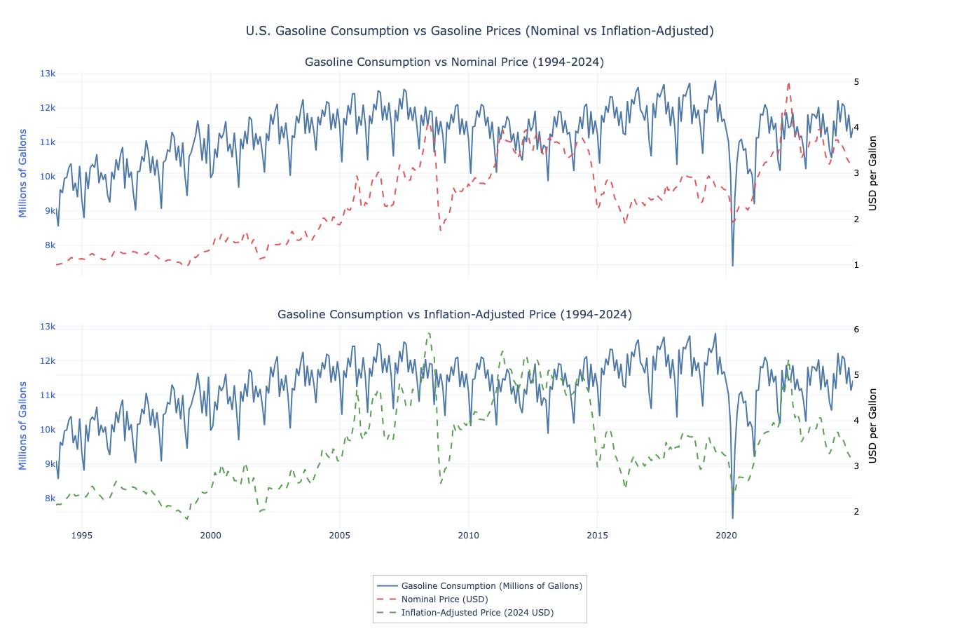

Slide 20
Analysis using Linear Regression

Slide 21
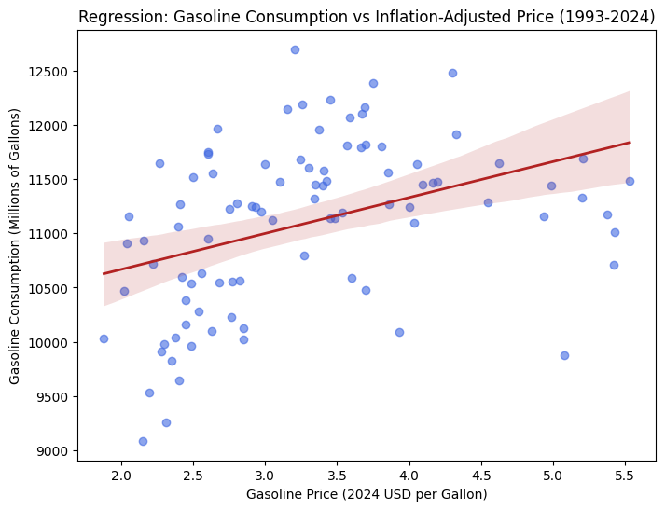
Linear Regression
X = ‘Inflation Adjusted Price’
Y = ‘Gasoline Consumption’
75% Train | 25% Test
Take Note:
Regression line doesn’t fit data
Data makes inverted and tilted U

Slide 22
Interpretation of Results
Millions of Gallons
9,911
10,297
10,683
11,069
11,455
11,841
$0
$1
$2
$3
$4
$5
Dollars per Gallon
Intercept = 9911.34
Slope = 386.04
R² = 0.14
RMSE = 704.38
Linear Regression can only explain 14% of the data
Prediction is off by average of 704.38 millions of gallons to actual consumption

Slide 23
Conclusion
Prices don’t have a large correlation to the change in Gasoline Consumption

Slide 24
Next Steps
Vehicle Registration Trends
  Total registration (up? down? consistent? random?
  Do EV’s replace combustion vehicles over time?
Different Models
  Multiple Linear Regression
  Segmented Regression
  ARIMA (Time-Series)
Global Events
  Compare effects of Global Events to the change in prices and consumption

Slide 25
Citations
U.S. Energy Information Administration. (n.d.). U.S. Product Supplied of Finished Motor Gasoline (Thousand Barrels per Day) [Data set]. U.S. Department of Energy. Retrieved October 26, 2025, from https://www.eia.gov/dnav/pet/pet_cons_psup_a_epm0f_vpp_mbbl_m.htm
U.S. Energy Information Administration. (n.d.). U.S. All Grades All Formulations Retail Gasoline Prices (Dollars per Gallon) [Data set]. U.S. Department of Energy. Retrieved October 26, 2025, from https://www.eia.gov/dnav/pet/pet_pri_gnd_dcus_nus_m.htm
U.S. Bureau of Labor Statistics. (n.d.). Consumer Price Index for All Urban Consumers: All Items (CPIAUCSL) [Data set]. Federal Reserve Bank of St. Louis. Retrieved October 26, 2025, from https://fred.stlouisfed.org/series/CPIAUCSL
Investopedia. (n.d.). Inelastic. Retrieved October 26, 2025, from https://www.investopedia.com/terms/e/inelastic.asp
OpenAI. (2025). ChatGPT (GPT-5) [Large language model]. Retrieved November 12, 2025, from https://chat.openai.com/

Slide 26
Peer Review Feedback Received
Time issues (8 mins)
Why do prices and consumption change?
  EV’s, political reasons, global events
Gasoline is always needed for cars, what’s the conclusion?
Global events are larger drivers in change of consumption than price
  Change the conclusion to include future ideas or new questions

